Slide 1
Ventricular Tachycardia in Structural Heart Disease
Dr Sanmath Shetty K
DM Cardiology Resident
Calicut Medical College

Slide 2
Overview
Premature Ventricular Complexes (PVCs)
VT in coronary artery disease
VT in Dilated Cardiomyopathy
Bundle Branch Reentrant (BBR) VT
Arrhythmogenic right ventricular dysplasia (ARVD)
VT in Hypertrophic Cardiomyopathy
VT long after repair of congenital heart disease
VT in patients with LV assist devices

Slide 3
Premature Ventricular Complexes (PVCs)
Premature impulses (complexes) that originate in the ventricles.
Usually benign.
Mechanisms:
  Extrasystoles:
    More frequent; induced by a mechanism related to the preceeding QRS complex.
    Most commonly due to reentry; less often induced by post potentials (triggered activity).
    Fixed or nearly fixed coupling interval.
  Parasystoles:
    Less frequent; independent of baseline rhythm.
    Due to presence of unidirectional entrance block in the parasystolic focus.
    Varying coupling intervals, interectopic intervals are multiples of each other and presence of fusion complexes.
Notes:
Benign prognosis in the absence of structural heart disease, in those with SHD associated with increased risk of SCD.
The parasystolic mechanism is generally explained by an entry block in the ectopic focus. The central point represents the parasystolic focus,
surrounded by an area with an entry block (shaded area). Parasystolic stimuli may be conducted out of this
zone but external stimuli cannot get into it. Usually, some degree of exit block also exists (see Figure 5.35).
Bottom: Scheme of parasystolic ventricular premature complexes with the characteristic three electrocardiographic
features: variable coupling interval (CI), multiple interectopic intervals, and fusion complexes

Slide 4
Extrasystole- Trigeminy
Parasystole

Slide 5
Lown Classification 1971
According to prognostic significance (Holter ECG)
Grade 0: No PVC
Grade 1: < 30/hr
Grade 2: > 30/hr
Grade 3: Polymorphic PVC
Grade 4a: In pairs
Grade 4b: Runs of monomorphic VT
Grade 5: R on T phenomenon

Slide 6
Electrocardiographic forms of presentation
Usually shows a compensatory pause(BC=2xAB)
  PVC usually fails to discharge SA node.
PVC discharges SA node, non complete compensatory pause(BC<2xAB).
At slow sinus rates, it enters AV junction leaving it in refractory period but does not prevent the next sinus impulse from being conducted towards the ventricles ( with a longer PR interval)--- interpolated PVC.

Slide 7
Morphologies of PVCs
In individuals with no evidence of heart disease:
  High voltage, unnotched QRS complexes.
  ST segment depression when QRS positive and vice versa.
  T wave has asymmetrical branches.
In individuals with heart disease:
  QRS complexes present notches and slurrings and are of low voltage.
  Symmetrical T waves.

Slide 8
Site of origin
RV ectopics: LBBB pattern
LV ectopics: RBBB pattern
  Superior axis: location in or near posterior division of left BB.
  Rightward axis: location in or near anterior division of left BB.
Ectopics from base: positive QRS complexes in precordial leads.
Ectopics from apex: negative QRS complexes in precordial leads.
QRS duration depends on:
  Site of origin
  Characteristics of tissues activated by the premature impulse
  Coupling time (QRS wider with short coupling interval)

Slide 9
VT in structural heart disease
History (eg: history of CAD, heart failure, cardiac surgery).
Physical examination
ECG:
  Baseline: abnormal Q waves, fragmented QRS complexes, IVCD, poor R wave progression.
  During VT: slurring of initial forces, lower amplitude and notching of QRS complexes.

Slide 10
VT in structural heart disease
Mechanisms
VT arises distal to the bifurcation of the His bundle in the specialized conduction system, ventricular muscle, or combinations of both.
Disorders of impulse formation
Enhanced automaticity
Triggered activity
Disorders of impulse conduction
Re-entry (circus movements)

Slide 11
VT in coronary artery disease
Incidence of VT varies according to the type of ACS.
GUSTO- 1 trial: 41,000 patients with STEMI treated with thrombolysis.
  VT – 3.5%.
Pooled analysis of 4 major trials in patients with UA/NSTEMI:
  VT- 0.8%.
Al-Khatib SM, Granger CB, Huang Y, et al: Sustained ventricular arrhythmias among patients with acute coronary syndromes with no ST-segment elevation: Incidence, predictors, and outcomes. Circulation 2002;106:309.
Clinical presentation – tolerated sustained VT to SCD.

Slide 12
SMVT within first 2 days of MI – 3% of cases
  Associated with increased in hospital mortality as against those without arrhythmias.
  Mortality not increased at 1 year in 30 day survivors.
During subacute/ healing phase of MI ( > 2 days)
  Associated with reduced LVEF and is a predictor of worse prognosis.
  SMVT within 3 months following MI – 40-50% mortality at 2 years.
  Predictors of increased mortality-
    Anterior wall MI
    Frequent episodes of sustained and/or nonsustained VT
    Heart failure
    Multivessel coronary disease, particularly in individuals with residual ischemia.
During chronic phase:
  Median time: 3 years; can first occur upto 10-15 years after MI.
  Annual mortality : 5 – 15% .

Slide 13
Mechanisms of VT in CAD
All arrhythmia mechanisms can converge in VT associated with CAD.
Reentry: VT associated with MI scar.
Automaticity: VT arising from ischemic border during acute ischemia.
Trigerred activity: VT arising during ischemia due to delayed or early after depolarization.

Slide 14
During acute ischemia
Acute ischemia activates ATP sensitive K channels causing increase in extracellular K along with acidosis and hypoxia in cardiac muscle.
Increased extracellular K
  greater resting depolarization
  decreased conduction velocity
  shortening of action potential duration
  prolongation of effective refractory period (postrepolarization refractoriness)
Increase in extracellular K depolarizes the RMP causing increase in tissue excitability.
Injury current flows between ischemic and non ischemic cells at border zone promoting focal activity in normal tissue.
Polymorphic VT due to microentry.
  Single reentrant wavefront splits into multiple wavelets when it enters surrounding nonischemic tissue (shorter effective refractory period).

Slide 15
Healing phases of MI
95% of these VTs due to reentry.
Two conditions essential for reentry:
  Unidirectional block of conduction.
  Circuit cycle longer than any of the refractory periods throughout the cycle.
Unidirectional block:
  Anatomical : discontinuities in ventricular muscle, branching strands of slow conduction or tissue discontinuation due to gap junction abnormalities present in the areas of MI scar.
  Functional : due to dispersion of refractoriness.

Slide 16
The substrate for VT develops gradually over 2 weeks following a MI.
  remains indefinitely once formed.
Triggers:
  Surges in autonomic tone
  Electrolyte imbalance
  Acute ischemia
  Acute heart failure decompensation

Slide 17
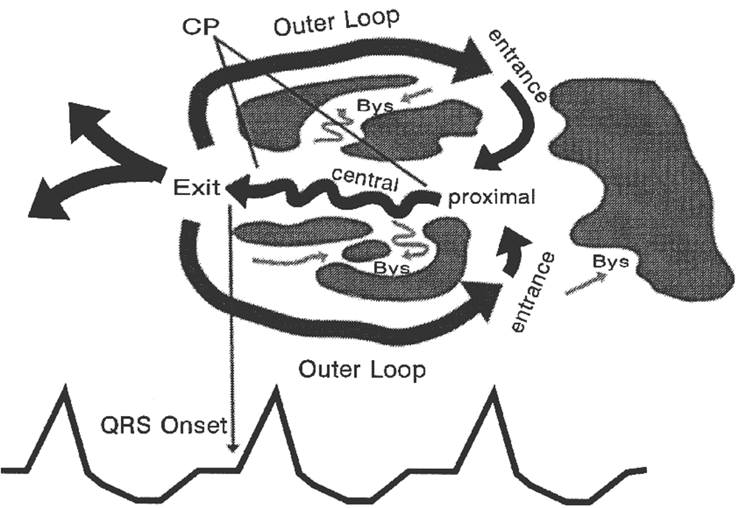
MI Scar-Related Sustained Monomorphic VT Circuit

Slide 18
Double loop “figure of 8” model
Isthmus: region of slow conduction within the scar.
  Target site for ablation.
Proximal and distal isthmus sites are the entrance and exit respectively.
The exit site is the point where the activation wavefront leaves the circuit to depolarize the ventricles.
  Determines VT morphology.
Outer loop connects entry and exit point by a lateral pathway around the border of the scar. Inner loop connects by a protected pathway within the scar.
Bystander sites are passively activated ; not integral to the circuit.

Slide 19
Clinical presentation
Mild symptoms (palpitations).
Symptoms of hypoperfusion (light headedness, altered sensorium, presyncope, syncope).
Exacerbation of angina and heart failure.
Sudden collapse.
Hemodynamic consequences depend on:
  Ventricular rate
  Duration of VT
  Presence and extent of LV dysfunction
  Loss of atrioventricular synchrony

Slide 20
ECG features suggesting VT related to old MI
Presence of Q waves (qR, QR or Qr) in related leads.
Notched or wide QRS complexes.
Low QRS voltage.
Multiple ventricular tachycardia morphologies.

Slide 21
Identifying the site of origin of VT in CAD
ECG tends to locate reentry circuit exit rather than site of VT origin.
Helpful tool to guide mapping and ablation during EP.
Localisation must be done in 3 axis:
Septal vs lateral walls
Superior vs inferior walls
Apical vs basal regions

Slide 22
Identifying the site of origin of VT in CAD
Lateral vs Septal
Lateral wall VTs:
  RBBB pattern
  Wider QRS
    Sequential activation of 2 ventricles.
Septal VTs:
  LBBB pattern
  Narrower QRS
    Parallel activation of both ventricles.
    Early engagement of HPS.

Slide 23
Identifying the site of origin of VT in CAD
Superior vs Inferior walls
QRS axis in inferior leads.
Superior axis: QRS negative in inferior leads.
Inferior axis: QRS positive in inferior leads.
IWMI: 80% have superior axis.
AWMI: 55% have superior axis.
45% have inferior axis.

Slide 24
Identifying the site of origin of VT in CAD
Basal vs Apical regions
QRS polarity in precordial leads.
VTs from base: positive concordant pattern.
VTs from apex: negative concordant pattern.

Slide 25
Epicardial origin
Rare in post MI VT, less than 2% of all cases.
More common in DCM (one third) and Chagas disease (70%).
Epicardial origin of ventricular activation widens the initial part of QRS complex – pseudo delta wave.
ECG intervals of ventricular activation that suggest an epicardial origin of the VT:
  pseudo–delta wave (measured from the earliest ventricular activation to the earliest fast deflection in any precordial lead) of 34 milliseconds or more [sensitivity- 83% and specificity- 95%]
  intrinsicoid deflection time in V2 (measured from the earliest ventricular activation to the peak of the R wave in V2) of more than 85 milliseconds [sensitivity- 87% and specificity- 90%]
  shortest RS complex duration (measured from the earliest ventricular activation to the nadir of the first S wave in any precordial lead) of 121 milliseconds or more [sensitivity- 76% and specificity- 85%]
  QRS duration is more than 200 milliseconds.
Notes:
When the initial activation starts in the endocardium, rapid depolarization of the ventricles
occurs along the specialized conducting system, resulting in a narrow QRS on the surface ECG and the
absence of a pseudo–delta wave. In contrast, when the initial ventricular activation occurs in the epicardium,
the intramyocardial delay of conduction produces a slurred initial part of the QRS complex.

Slide 26
Principles of Management
Acute Management:
VTs with hemodynamic compromise: DC version.
Medical management:
  Amiodarone drug of choice.
  Procainamide and sotalol are alternatives.
  Lidocaine less effective in the absence of ischemia.
  Beta blockers offer additional benefit.
Treatment of underlying conditions (eg: acute ischemia, decompensated heart failure, electrolyte abnormalities)

Slide 27
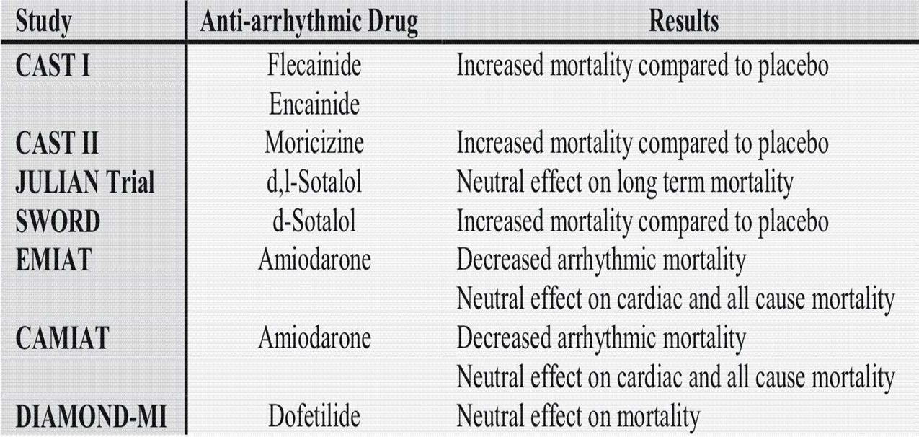
Long term management
Notes:
CAST: Cardiac arrhythmia suppression trial.
EMIAT: European myocardial infarction amiodaraone trial.
CAMIAT: Canadian Amiodarone myocardial infarction arrhythmia trial

Slide 28
Long term management
Prevention of SCD- ICD implantation.
Adjunctive antiarrhythmic therapy
  Reduce the frequency of ventricular arrhythmia in patients with unacceptably frequent ICD therapy
  Reduce the rate of VT so that it is better tolerated hemodynamically and more amenable to pace termination or low-energy cardioversion
  Suppress other arrhythmias (e.g., sinus tachycardia, AF, nonsustained VT) that cause symptoms or interfere with ICD function resulting in inappropriate discharges.
Catheter ablation of post-MI VT: 2 indications
  Recurrent VT causing frequent ICD shocks and refractory to antiarrhythmic medications
  VT storm or incessant VT refractory to antiarrhythmic medications.

Slide 30
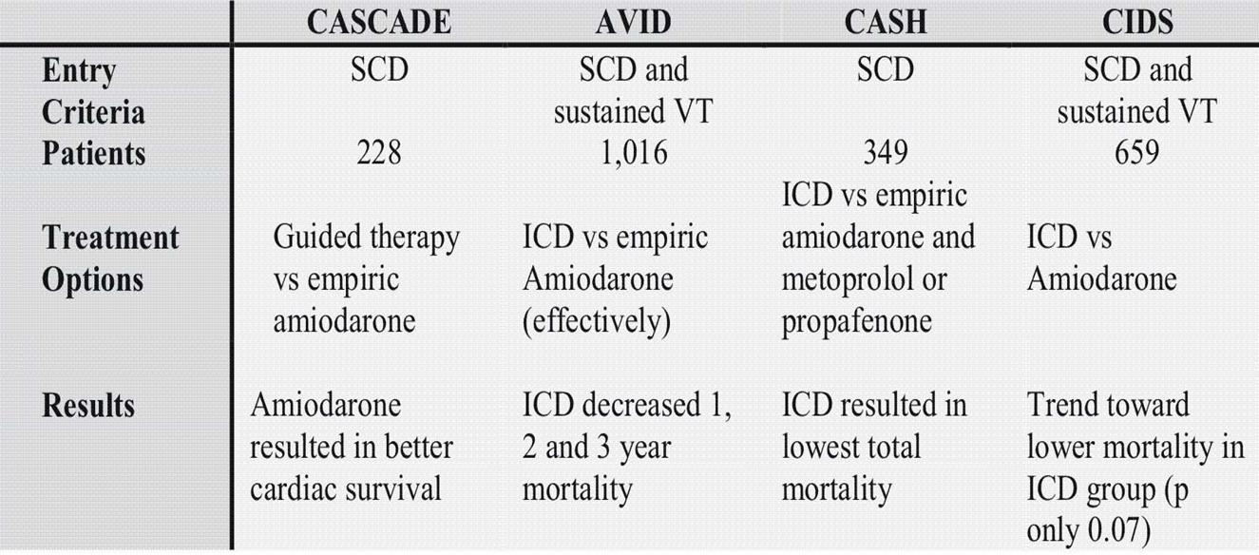
Long term management
Secondary Prevention of SCD

Slide 31
Long term management
Primary Prevention of SCD in Ventricular Arrhythmias
TRIAL | CONTROL | NO OF PTS | POPULATION | MEAN FOLLOW UP(mths) | MORTALITY% CONTROL | MORTALITY% ICD | P VALUE
MADIT | Anti arrhythmic therapy | 196 | Prior MI; LVEF < 35%, asymptomatic NSVT | 27 | 39 | 16 | 0.02
CABG-PATCH | Anti arrhythmic therapy | 900 | For CABG: LVEF < 35%. Positive SAECG | 32 | 21 | 22 | 0.64
MUSTT | Conventional therapy | 704 | Prior MI; LVEF < 40%; NSVT, inducible VT on EP study | 39 | 48 | 24 | 0.001
MADIT II | Conventional therapy | 1232 | Prior MI; LVEF < 30% | 20 | 20 | 14 | 0.007
DINAMIT | Conventional therapy | 674 | Recent MI (within 6-40 d), LVEF < 35%; impaired heart rate variability | 39 | 18 | 17 | 0.66

Slide 32
Guidelines for ICD in CAD
Secondary prevention
ICD therapy is indicated in patients who are survivors of cardiac arrest due to VF or hemodynamically unstable sustained VT after evaluation to define the cause of the event and to exclude any completely reversible causes. (Class I; LOE A)
Patients experiencing cardiac arrest due to VF 48 hrs after MI must be optimally evaluated and treated for ischemia.
Evidence of ischemia – complete coronary revascularization.
ICD if revascularization is not possible and there is significant LV dysfunction.

Slide 33
Guidelines for ICD in CAD
Primary prevention
Class I:
Patients with LVEF less than or equal to 35% due to prior MI who are at least 40 days post-MI and are in NYHA functional Class II or III. (LOE: A).
Patients with LV dysfunction due to prior MI who are at least 40 days post-MI, have an LVEF less than or equal to 30%, and are in NYHA functional Class I. (LOE: A).
Patients with nonsustained VT due to prior MI, LVEF less than or equal to 40%, and inducible VF or sustained VT at electrophysiological study. (LOE: B).

Slide 34
VT in Dilated Cardiomyopathy
Multiform VPCs, ventricular pairs, NSVT- 80%-95% DCM patients.
Ventricular arrhythmias more frequent and complex as LV function deteriorates.
  NSVT 15%-20% in NYHA I/II to 50%-70% in NYHA IV.
VT may arise in the myocardium or may be through macroentrant circuit ( BBR- VT).
BBR-VT --- Responsible for VT in up to 41% of DCM.
Notes:
Absolute risk of SCD increases with worsening LV function but ratio of sudden to nonsudden deaths is inversely related to the extent of functional impairnment.

Slide 36
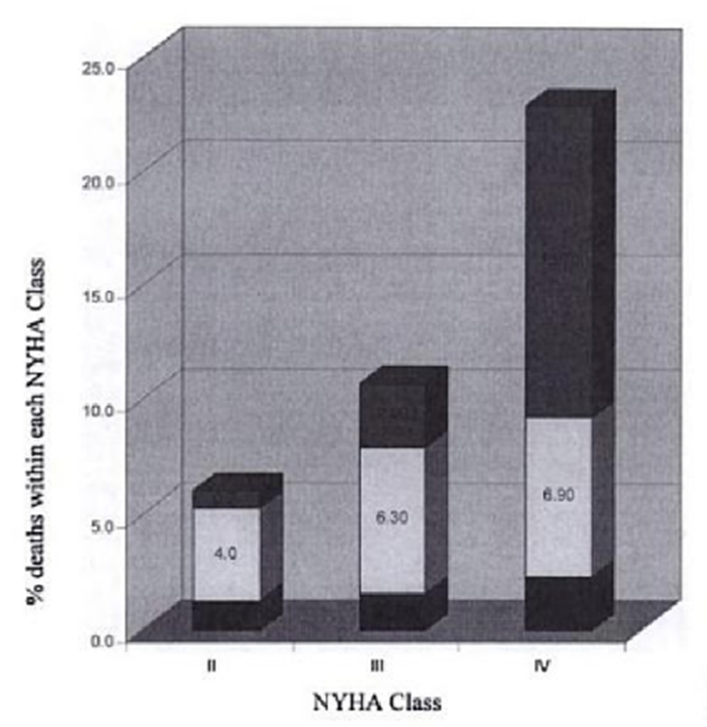
Predictors of arrhythmia and mortality
Clinical predictors
Severity of LV dysfunction
  As CHF symptoms worsen,
    Risk of total mortality, sudden death and CHF death increases.
    Ratio of sudden death to CHF death decreases.
  Once pt develop class IV symptoms, EF less valuable in predicting mortality.
Syncope
  1 yr SCD rates increases from 12% to 45% when syncope is present.
Notes:
HF deaths
Sudden deaths
Other deaths.

Slide 37
Laboratory values:
Low serum sodium
High plasma norepinephrine, renin and ANP,BNP levels.
ECG predictors:
LBBB
First and second degree AV block
Predictive testing with EP in DCM patients not associated with CAD is controversial.
  Presence of polymorphic VT on EPS does not predict risk for SCD.
  Induction of sustained monomorphic VT identifies high risk population.
  Lack of inducible VT does not predict freedom from sudden death.

Slide 38
Effect of HF therapy on ventricular arrhythmias
Beta blockers: substantial part of the survival benefit seen is due to a significant reduction in SCD.

Slide 39
Effect of HF therapy on ventricular arrhythmias
ACEI and ARBs: improved survival; conflicting data with reduction in SCD.
CONSENSUS, SOLVD, SAVE – little or no reduction in SCD.
V-HeFT, TRACE, AIRE – significant reduction in SCD.
Aldosterone antagonists: Reduce overall mortality and SCD in advanced HF.
  Reduction in aldosterone effect on the heart
  Maintenance of higher potassium levels
Digoxin and other inotropes: Proarrhythmic effect
  DIG trial: no net mortality benefit, apparent increase in mortality from arrhythmias ( not statistically significant).

Slide 40
Antiarrhythmics:
Amiodarone:
Initial trials GESICA: mortality benefit.
SCD- HeFT: mortality not reduced compared to placebo.
Recommended only for reducing the frequency of shocks in patients with recurrent ventricular arrhythmias (Class IIa).

Slide 41
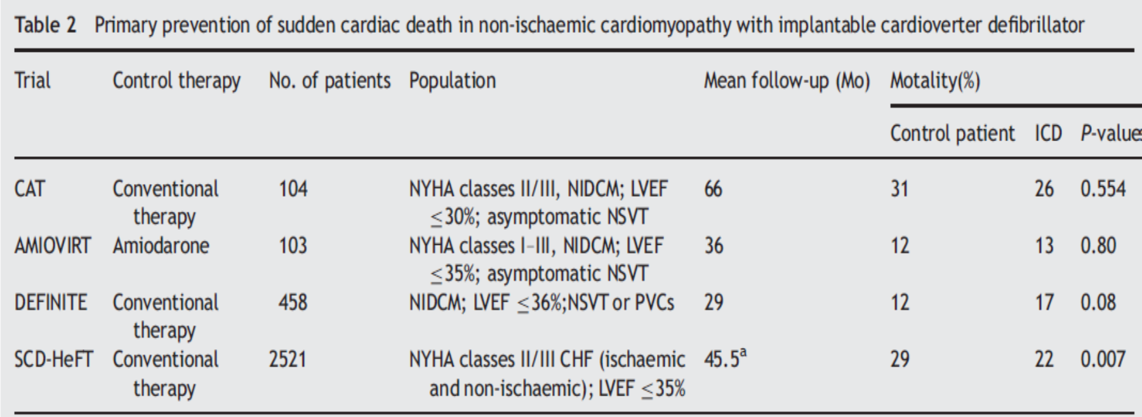
Primary prevention with ICD
Notes:
CAT, Cardiomyopathy Trial; AMIOVIRT, Amiodarone vs. Implantable Defibrillator in Patients with Non-ischaemic Cardiomyopathy and Asymptomatic Nonsustained
Ventricular Tachycardia; DEFINITE, Prophylactic Defibrillator Implantation in Patients with Non-ischaemic-Dilated Cardiomyopathy; SCD-HeFT,
Sudden Cardiac Death in Heart Failure Trial;

Slide 42
ICD
Primary prevention of SCD:
Patients with nonischemic DCM who have an LVEF less than or equal to 35% and who are in NYHA functional Class II or III. ( Class I; LOE B).
Patients with unexplained syncope, significant LV dysfunction, and nonischemic DCM. ( Class IIa; LOE C).
Patients with nonischemic DCM who have an LVEF of less than or equal to 35% and who are in NYHA functional Class I. (Class IIb; LOE C).
Secondary prevention:
ICD is the preferred treatment in DCM patients with resuscitated cardiac arrest from VT/VF.

Slide 43
Bundle Branch Reentrant (BBR) VT
Only reentrant VT with a well-defined reentry circuit.
The right bundle branch (RB) and left bundle branch (LB) obligatory limbs of the circuit.
Connected proximally by the His bundle (HB) and distally by the ventricular septal myocardium.
Cannot be induced in patients with normal His Purkinje system (HPS)
  Electrophysiological properties of normal HPS- very fast conduction velocity and a relatively long refractory period precludes formation of a stable circuit.

Slide 44
Epidemiology
6% of induced sustained monomorphic VT.
Additional myocardial VTs in 25% patients.
Commonly seen in patients with DCM.
  DCM anatomic substrate in 45% of BBR-VT ; 41% of all VTs in DCM patients is BBR-VT.
Also seen in
Ischemic cardiomyopathy (incidence 4.5 - 6%).
Valvular heart disease
  Aortic or mitral valve surgery can facilitate BBR-VT- close proximity of HPS to valvular annuli.
Ebstein’s anomaly.
Hypertrophic cardiomyopathy.
Myotonic dystrophy.
Conduction anomalies associated with sodium blockade with flecainide.
Notes:
In contrast to postoperative myocardial re entrant VT, BBR VT usually occurs in early postop period (<2 wks) and can be associated with preserved LV systolic function

Slide 45
Changes from normal physiology for BBR to be sustained:
Anatomically longer reentrant pathway (dilated heart)
Slow conduction in HPS (HPS disease)
Sufficient prolongation of conduction time to allow expiration of refractory period of HPS.

Slide 46
Types of BBR-VT
LBBB morphology is commoner.
Type A and C are classical BBR-VTs.
Type B is most commonly seen in CAD especially those with AWMI with LAF or LPF block.

Slide 47
Clinical presentation
Typically unstable.
  Very rapid ventricular rates (200-300/min) and poor underlying ventricular function.
75% present with syncope or cardiac arrest.
Baseline ECG:
  NSR or Atrial fibrillation.
  Nonspecific IVCD and PR prolongation – most common ECG abnormality.
  Typical bundle branch patterns may also be seen.
  Rarely narrow baseline QRS complex- suggesting role of functional conduction delay.
ECG during VT:
  Typical BBB pattern, may resemble that seen in NSR. LBBB>RBBB. Usually leftward axis.
  Rapid intrinsicoid deflection in right precordial leads.
    Initial ventricular activation through HPS, not ventricular muscle.
Notes:
Although total interruption of conduction in one of the bundle branches would theoretically prevent occurrence of bundle branch reentry, an ECG pattern of “complete” bundle branch block may not be an accurate marker of complete block.

Slide 48
EP testing
Prolonged HV interval invariably present in sinus rhythm.
Some patients with normal HV interval manifest as HV interval prolongation or split HB potentials during atrial programmed stimulation or burst pacing.
Tachycardia Induction:
VES from RV apex usual method.
Dependent on achievement of critical conduction delay in HPS following VES.
At longer coupling intervals, retrograde conduction occurs through RB. At shorter coupling intervals, retrograde block occurs in RB.
Retrograde conduction occurs via LB causing long V2-H2 interval.
Further shortening of coupling intervals, increased retrograde LB delay allowing anterograde conduction of the RB ( beat with wide QRS LBBB pattern- BBR beat or V3 phenomenon).
Notes:
Ventricular extra stimuli
LB would still be capable of retrograde conduction because of the delay associated with transseptal conduction.

Slide 49
EP testing
Tachycardia features:
  AV dissociation usually present; 1:1 ventriculoatrial conduction may occur.
  His potential precedes the QRS.
  HV interval during BBR similar or longer than that during baseline.
  Spontaneous variations in V-V intervals are preceeded and dictated by similar changes in H-H intervals.
  Termination of VT with block in HPS.
  Inability to induce VT after ablation of right or left bundle branch.

Slide 50
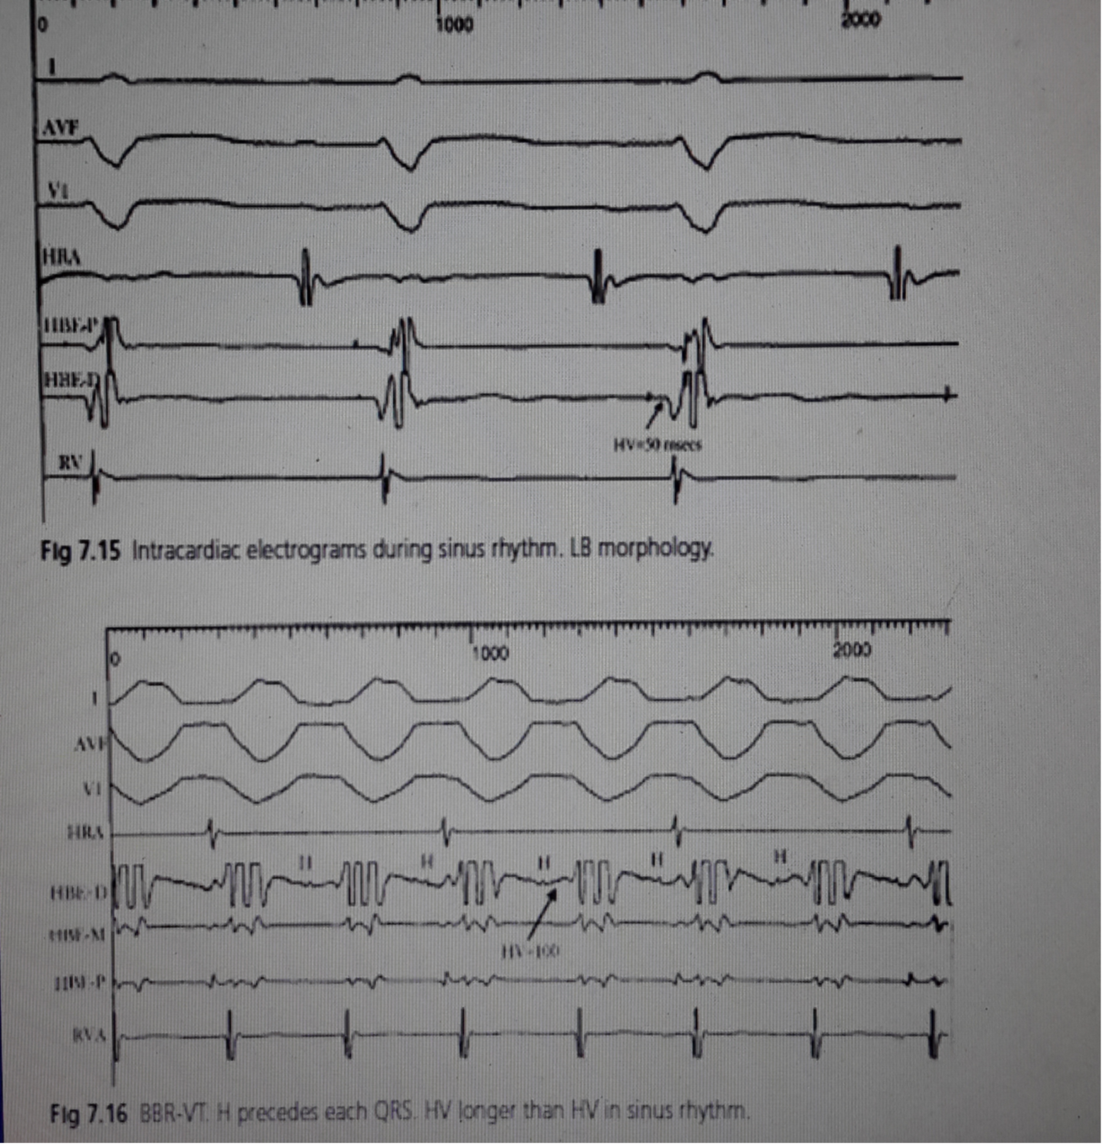

Slide 51
Interfascicular VT:
  HV interval during tachycardia usually shorter by more than 40 msec than that recorded during sinus rhythm.
  LB potential inscribed before His potential.

Slide 52
Treatment
Pharmacological therapy usually ineffective.
RFA of a bundle branch first line therapy.
RB ablation easier; method of choice.
LB ablation preferable in patients with conduction system disease such that conduction down the LB is inadequate to maintain 1:1 conduction.
  Mere presence of LBBB on ECG does not mean complete block in LB.
Pacemaker implantation indicated when infrahisian AV block is demonstrated during atrial pacing or when postablation HV interval > 100 msecs.
  Varies from 10-30%.
  Prophylactic pacemaker in myotonic dystrophy patients in view of progressive nature of the conduction system disease.
Recurrence rare. Mortality after successful ablation mostly due to progressive heart failure and associated myocardial VTs (25%).
  Treatment: ICD with or without CRT capabilities.
Notes:
Favour LB ablation over RB:
Development of high grade AV block below the HB on transient RBBB that can occur secondary to RV catheter manipulation.
Observation of a LB potential following the ventricular electrogram either intermittently or during each sinus beat.

Slide 53
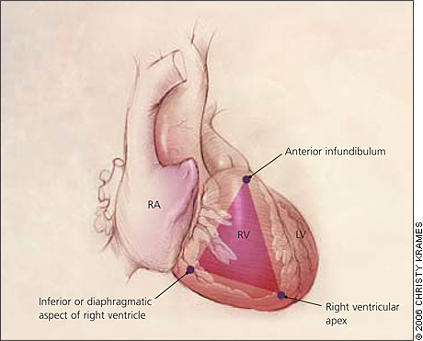
Arrhythmogenic right ventricular dysplasia(ARVD)
Progressive disease in which normal myocardium is replaced by fibrofatty tissue.
Usually involves the RV; LV and septum may also be involved.
Predominantly involves the “ Triangle of Dysplasia”.
Occurs in young adults (80% in less than 40 years) and more common in males.
Prevalence 0.02 to 0.1%.

Slide 54
Pathogenesis
Several proposed theories.
  Familial inheritance- autosomal dominant or recessive.
  Metabolic disorder affecting RV.
  Infectious or immunological cause.
Mutations in desmosomal proteins- desmoglein, desmoplakin, desmocollin, plakoglobin, plakophilin.
Autosomal recessive inheritance
  Familial palmoplantar keratosis, Naxos disease, mal de Meleda disease.
  Hyperkeratosis of palms and soles, woolly hair.
  Cardiac anomalies- 100 % penetrant by adolescence- RV involvement 100%, LV involvement 27%.

Slide 55
Mechanism of arrhythmia

Slide 56
Clinical presentation
Fatigue, atypical chest pain, palpitations, syncope or sudden cardiac death.
Ventricular arrhythmias in ARVD- 23% (mild disease) to 100% (severe disease).
Occur during exercise.
Patients with ARVD with increased risk of SCD:
  Younger patients
  Patients with recurrent syncope
  Patients with previous history of cardiac arrest or VT with hemodynamic compromise
  Patients with LV involvement
  Patients with ARVD2 and Naxos disease
  Patients with an increase in QRS dispersion
Notes:
Maximum measured QRS duration – minimum measured QRS duration > 40 msec

Slide 57
ECG abnormalities
Notes:
TAD= terminal activation duration

Slide 58
Notes:
2 major or 1 major plus 2 minor or 4 minor criteria

Slide 59
Echocardiography:
    Dilation of the RV and RV dysfunction (Revised task force criteria)
    localised aneurysms in diastole
    dyskinesis in the inferior basal region.
RV angiography:
    Findings: infundibular aneurysms, trabeculae thicker than 4mm “deep fissures”, prominent moderator band, diastolic bulging of the subtricuspid area, mild tricuspid regurgitation.
Cardiac MRI:
    Abundant epicardial adipose tissue, prominent trabeculations, scalloped appearance of RV free wall and intramyocardial fat deposits.
Endomyocardial Biopsy:
    Gold Standard; lacks sensitivity (67%). Performed from septum; changes more pronounced in free wall
Notes:
RV angiogram : 45 RAO and 45 LAO
Endomyocardial biopsy gold standard: drawbacks lacks sensitivity only 67%. For safety reasons its performed only at the septum whereas typical changes are more pronounced in the free wall.

Slide 60
Management
Pharmacological therapy:
  Beta blockers, sotalol and amiodarone.
  Class Ia and Ib drugs ineffective.
Radiofrequency ablation:
  Frequently unsuccessful and may need multiple attempts.
    Progressive nature of the disease and diffuse yet patchy nature (multiple arrhythmogenic foci)
  Fontaine et al. reported success rates of 32%, 45% and 66% after one, two or three ablation sessions in 50 patients.
ICD:
  Patients with high risk of SCD.
    Those resuscitated from cardiac arrest, history of syncope or life threatening arrhythmias not completely suppressed by drug therapy.
  Problems with ICD:
    Areas of RV myocardium thin and non contractile – penetrated during RV lead placement leading to tamponade.
    Fibrofatty nature of RV – device inadequately sensing arrhythmias.
Notes:
Beta blockers reduce the possibility of adrenergically stimulated arrhythmia.

Slide 61
VT in HCM
Highly variable natural history.
  Beta myosin heavy chain mutations: relationship between severity of LVH and risk of SCD.
  Troponin mutations: high risk of SCD irrespective of LVH.
Mortality rates : 1%/yr.
  SCD : 0.2%/yr.
SCD
  usually in patients with mild or no symptoms.
  common in adolescents and young adults before the age of 30-35 yrs.
Predominant mechanism of SCD: VT/VF
  Other mechanisms: asystole, rapid atrial fibrillation, electrical mechanical dissociation.

Slide 62
Sudden cardiac death
Risk factors
Major risk factors
Prior personal history of sudden cardiac death or out-of-hospital cardiac arrest
Spontaneous sustained ventricular tachycardia or ventricular fibrillation
Family history of sudden cardiac death
Extreme left ventricular hypertrophy (>30 mm)
Nonsustained ventricular tachycardia
Abnormal blood pressure response to exercise
Recent, unexplained syncope
Delayed gadolinium enhancement on cardiac magnetic resonance imaging*
Presence of LVOT obstruction is not a sole risk factor for SCD.
EP study not shown to be of benefit for risk stratification in HCM.

Slide 63
Prevention of SCD
ICD:
Patients with HCM who have 1 or more major risk factors for SCD. (Class IIa; LOE: C)
Pharmacologic therapy: amiodarone
  obsolete strategy; lacks proven efficacy.
  Likelihood of side effects during the long risk period typical of young patients with HCM.

Slide 64
VT long after repair of congenital heart disease
VT accounts for 38% of wide complex tachycardias in patients with congenital heart disease.
VT late after repair occur in those with TOF and VSD.
Predictors for sustained VT:
  QRS duration >180msec, rapid increase in QRS duration after repair, dispersion of QRS duration on ECG, increased QT interval dispersion, complete heart block, older age at surgery (>10yrs), presence of RVOT patch, RVOT aneurysm, increased RV pressures, pulmonic or tricuspid regurgitation.
Monomorphic and macrorentrant, rotating clockwise or anticlockwise around myotomy scars or surgical patches.

Slide 65
VT in patients with LV assist devices
Not uncommon owing to significant underlying structural heart disease.
De novo monomorphic VT may occur after LVAD is implanted.
60% suffer from monomorphic VT after implantation of LVAD.
Majority have an exit site close to the region of the inflow cannula at the LV apex.

Slide 66
THANK YOU

